Slide 1
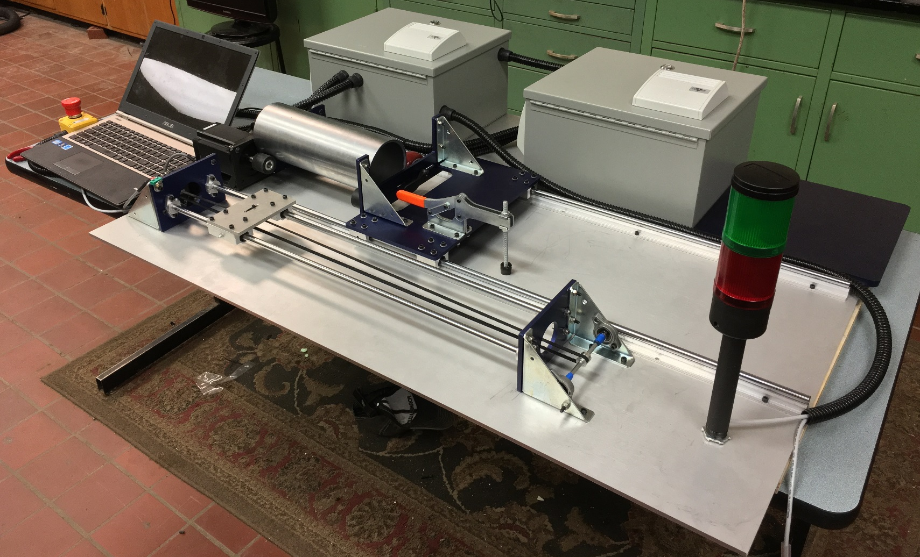
Picture of Final Product – ‘Lathe’ Style Automated Machine
Logic Control Module
Power Distribution Module
Drive Motor
Adjustable End Plate

